Slide 1
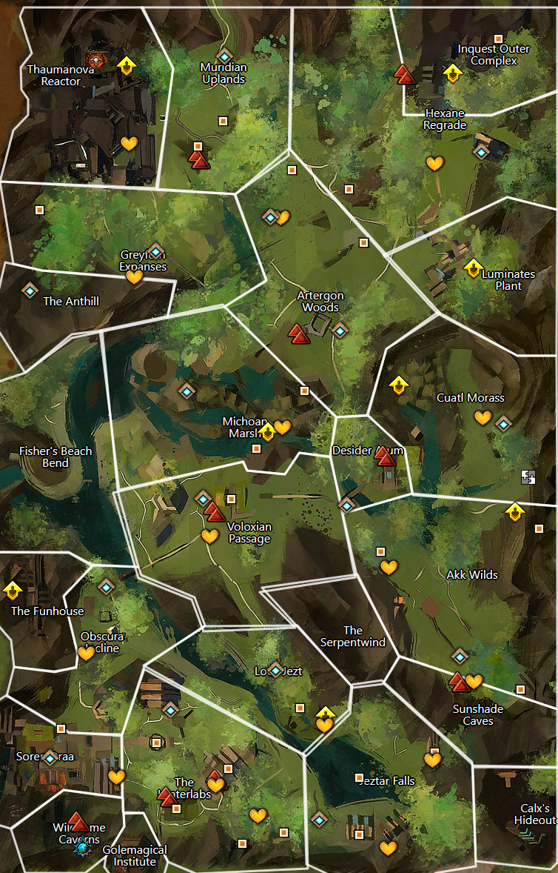
21
14
1-welcome inventor
2-brain washing
3-interrupting research
4-not even the frogs are safe, note about fun house
5-open up it’s the….
6-plot to disrupt power to metrica
7-too busy with the rats
8-zojja drops in to send a message, pick up a crafting profesion.
9- She heard from a frog about a hidden entrance. Go ask for more details
10-frogs talk about how hunters in west report weird lights
11-found corpses of skritt and krait around a chaotic shard, look for local skritt den
12-holy broken core
13-assault the complex to see about notes on the power grid plan
14-find hologram of assault plan, return and head over to luminates plant
15-return refugees and continue on over to powergrid
16-keep powergid safe
17-turrets online, inquest complex to north threatens
18-thinning the herd
19-recover note mentioning thaumanuova - sabotage golem
20-stolen core taken north, theft covered up by toxins from failed experiment stay and help or move on
21-go find the stolen reactor core
19
1-zojja-
18
20
13
15
16
17
12
11
10
9
9a
8
7
6
5
4
1
2
3

Slide 2

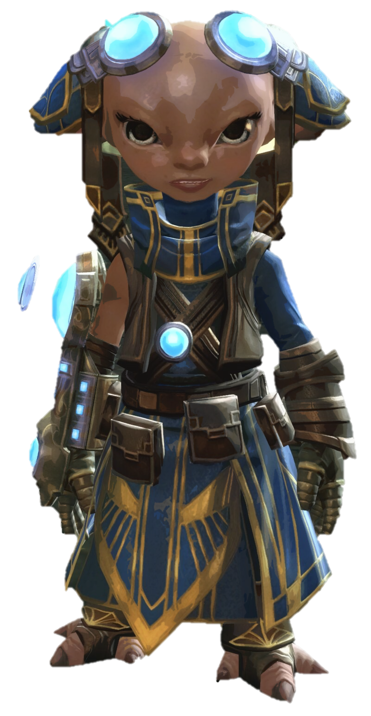
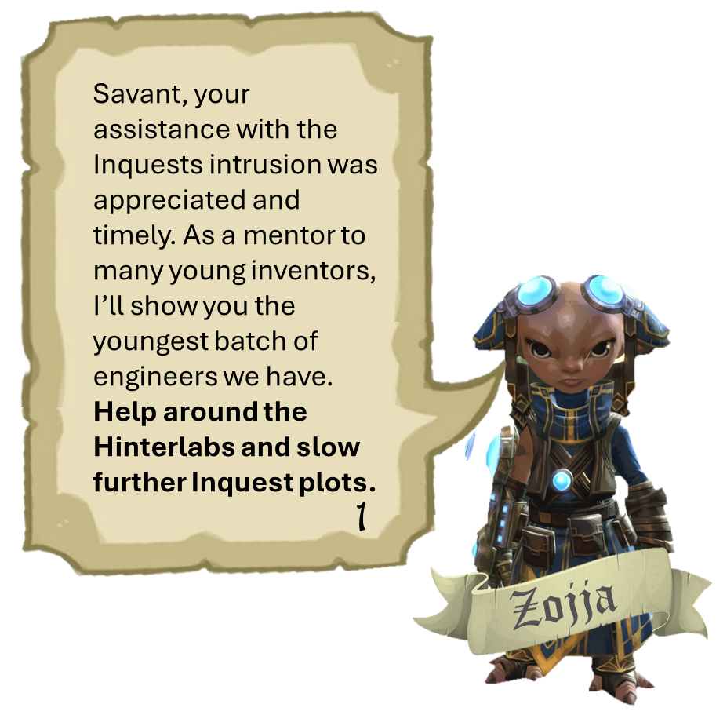

1-welcome inventor
2-brain washing
3-interrupting research
4-not even the frogs are safe, note about fun house
5-open up it’s the….
6-plot to disrupt power to metrica
7-too busy with the rats
8-zojja drops in to send a message, pick up a crafting profesion.
9- She heard from a frog about a hidden entrance. Go ask for more details
10-frogs talk about how hunters in west report weird lights
11-found corpses of skritt and krait around a chaotic shard, look for local skritt den
12-holy broken core
13-assault the complex to see about notes on the power grid plan
14-find hologram of assault plan, return and head over to luminates plant
15-return refugees and continue on over to powergrid
16-keep powergid safe
17-turrets online, inquest complex to north threatens
18-thinning the herd
19-recover note mentioning thaumanuova - sabotage golem
20-stolen core taken north, theft covered up by toxins from failed experiment stay and help or move on
21-go find the stolen reactor core
Savant, your assistance with the Inquests intrusion was appreciated and timely. As a mentor to many young inventors, I’ll show you the youngest batch of engineers we have.
Help around the Hinterlabs and slow further Inquest plots.
1
Zojja

Slide 3
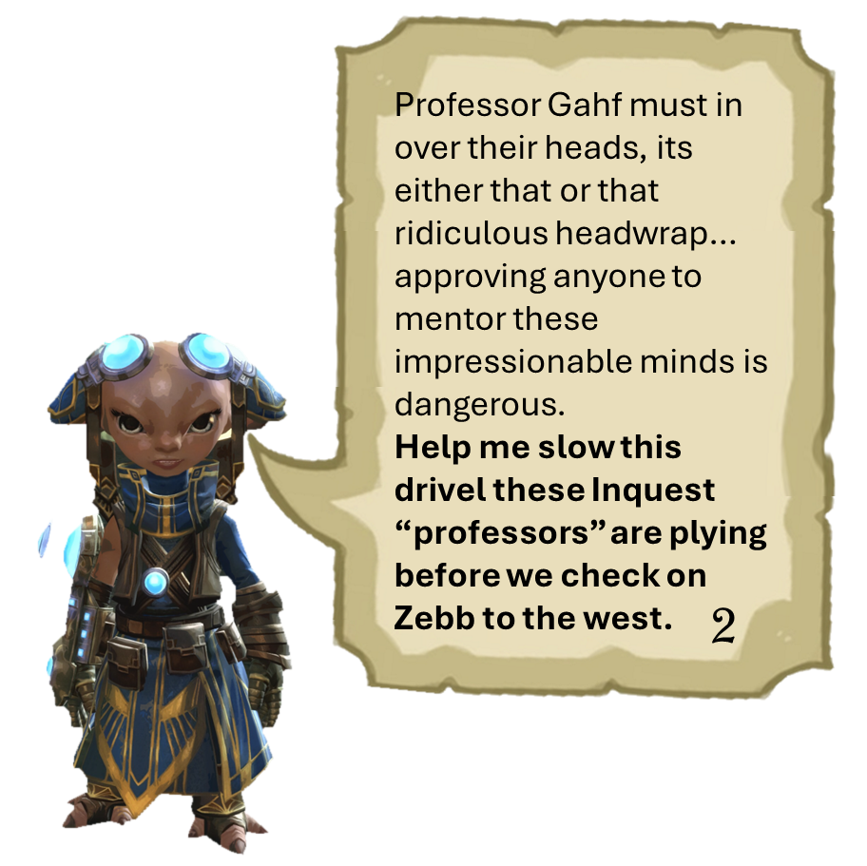
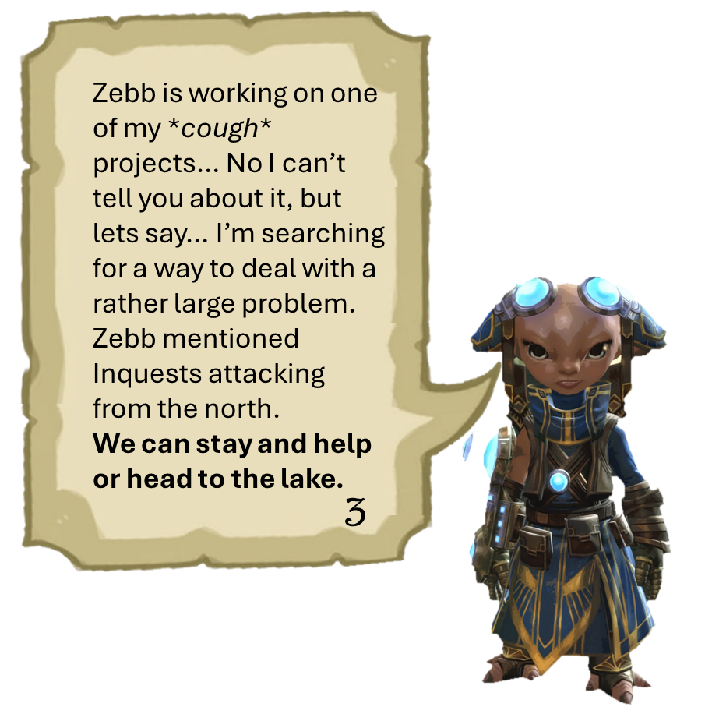
1-welcome inventor
2-brain washing
3-interrupting research
4-not even the frogs are safe, note about fun house
5-open up it’s the….
6-plot to disrupt power to metrica
7-too busy with the rats
8-zojja drops in to send a message, pick up a crafting profesion.
9- She heard from a frog about a hidden entrance. Go ask for more details
10-frogs talk about how hunters in west report weird lights
11-found corpses of skritt and krait around a chaotic shard, look for local skritt den
12-holy broken core
13-assault the complex to see about notes on the power grid plan
14-find hologram of assault plan, return and head over to luminates plant
15-return refugees and continue on over to powergrid
16-keep powergid safe
17-turrets online, inquest complex to north threatens
18-thinning the herd
19-recover note mentioning thaumanuova - sabotage golem
20-stolen core taken north, theft covered up by toxins from failed experiment stay and help or move on
21-go find the stolen reactor core
Professor Gahf must in over their heads, its either that or that ridiculous headwrap… approving anyone to mentor these impressionable minds is dangerous.
Help me slow this drivel these Inquest “professors” are plying before we check on Zebb to the west.
Zebb is working on one of my *cough* projects… No I can’t tell you about it, but lets say… I’m searching for a way to deal with a rather large problem. Zebb mentioned Inquests attacking from the north.
We can stay and help or head to the lake.
2
3

Slide 4
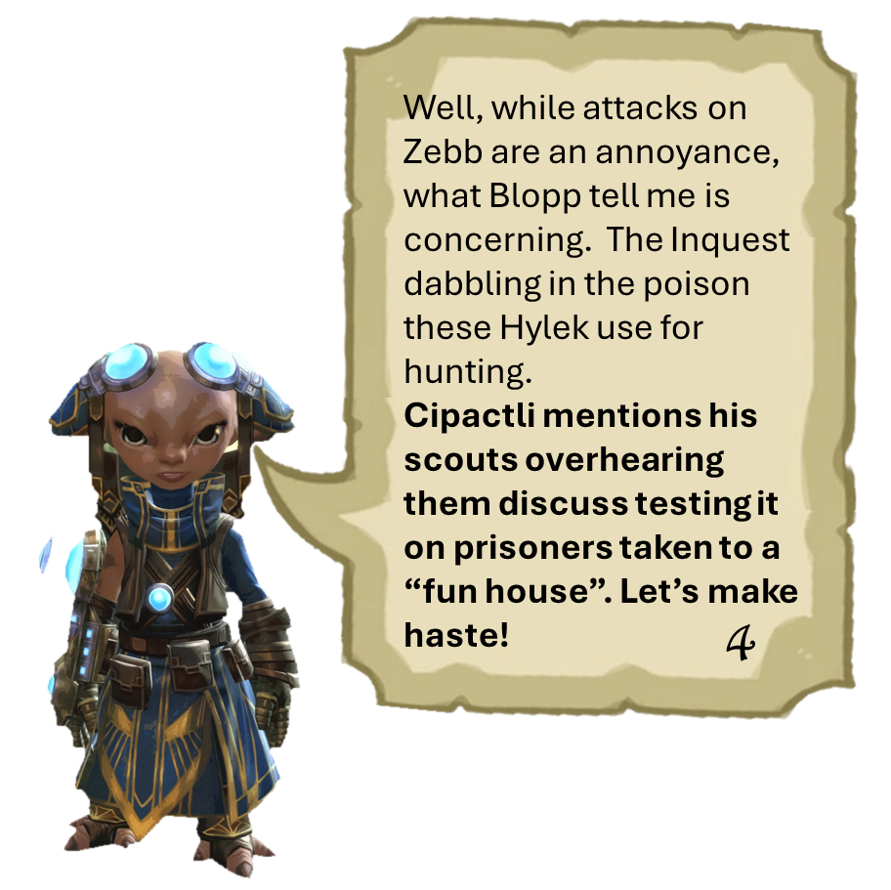
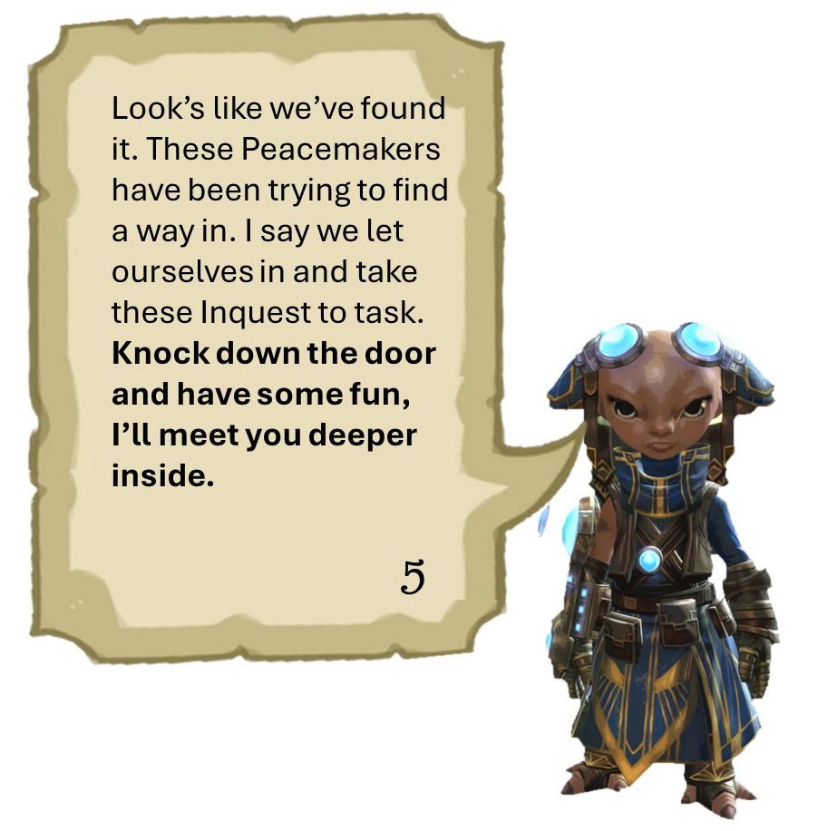
1-welcome inventor
2-brain washing
3-interrupting research
4-not even the frogs are safe, note about fun house
5-open up it’s the….
6-plot to disrupt power to metrica
7-too busy with the rats
8-zojja drops in to send a message, pick up a crafting profesion.
9- She heard from a frog about a hidden entrance. Go ask for more details
10-frogs talk about how hunters in west report weird lights
11-found corpses of skritt and krait around a chaotic shard, look for local skritt den
12-holy broken core
13-assault the complex to see about notes on the power grid plan
14-find hologram of assault plan, return and head over to luminates plant
15-return refugees and continue on over to powergrid
16-keep powergid safe
17-turrets online, inquest complex to north threatens
18-thinning the herd
19-recover note mentioning thaumanuova - sabotage golem
20-stolen core taken north, theft covered up by toxins from failed experiment stay and help or move on
21-go find the stolen reactor core
Well, while attacks on Zebb are an annoyance, what Blopp tell me is concerning. The Inquest dabbling in the poison these Hylek use for hunting.
Cipactli mentions his scouts overhearing them discuss testing it on prisoners taken to a “fun house”. Let’s make haste!
Look’s like we’ve found it. These Peacemakers have been trying to find a way in. I say we let ourselves in and take these Inquest to task. Knock down the door and have some fun, I’ll meet you deeper inside.
5
4

Slide 5
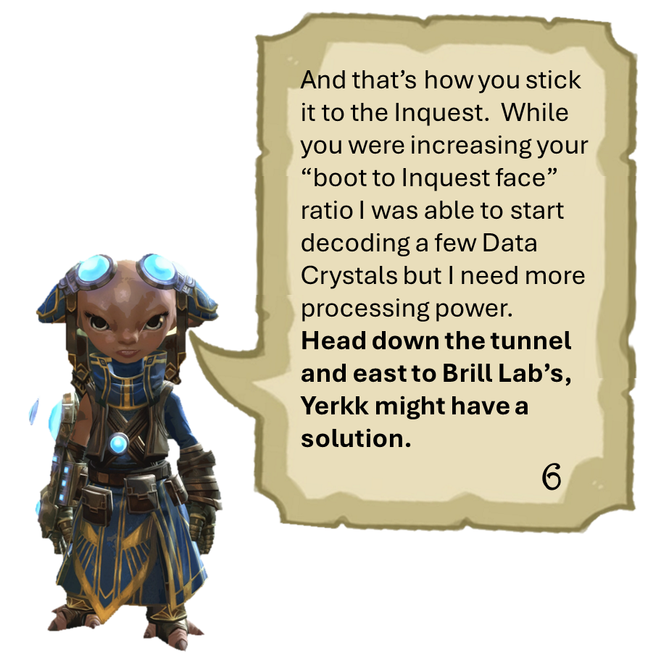
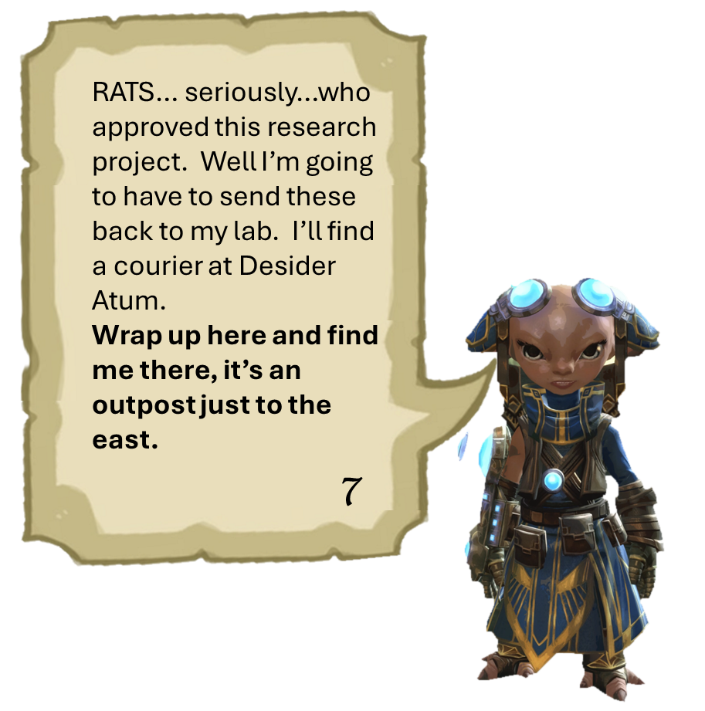
1-welcome inventor
2-brain washing
3-interrupting research
4-not even the frogs are safe, note about fun house
5-open up it’s the….
6-plot to disrupt power to metrica
7-too busy with the rats
8-zojja drops in to send a message, pick up a crafting profesion.
9- She heard from a frog about a hidden entrance. Go ask for more details
10-frogs talk about how hunters in west report weird lights
11-found corpses of skritt and krait around a chaotic shard, look for local skritt den
12-holy broken core
13-assault the complex to see about notes on the power grid plan
14-find hologram of assault plan, return and head over to luminates plant
15-return refugees and continue on over to powergrid
16-keep powergid safe
17-turrets online, inquest complex to north threatens
18-thinning the herd
19-recover note mentioning thaumanuova - sabotage golem
20-stolen core taken north, theft covered up by toxins from failed experiment stay and help or move on
21-go find the stolen reactor core
And that’s how you stick it to the Inquest. While you were increasing your “boot to Inquest face” ratio I was able to start decoding a few Data Crystals but I need more processing power.
Head down the tunnel and east to Brill Lab’s, Yerkk might have a solution.
RATS… seriously…who approved this research project. Well I’m going to have to send these back to my lab. I’ll find a courier at Desider Atum.
Wrap up here and find me there, it’s an outpost just to the east.
7
6

Slide 6
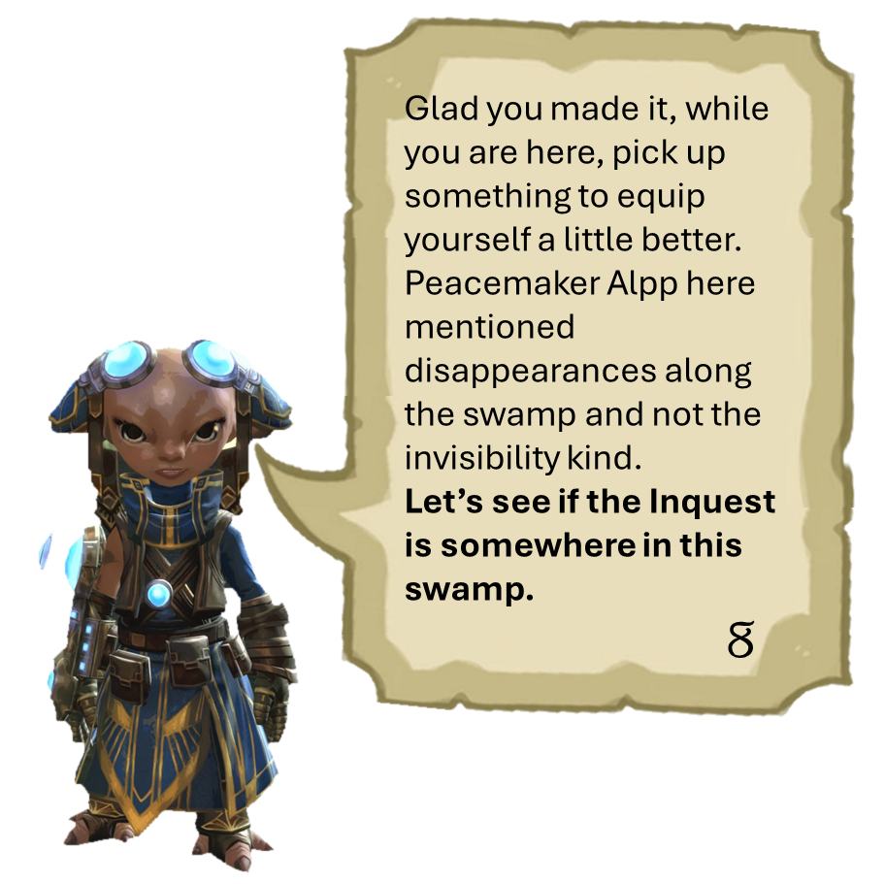
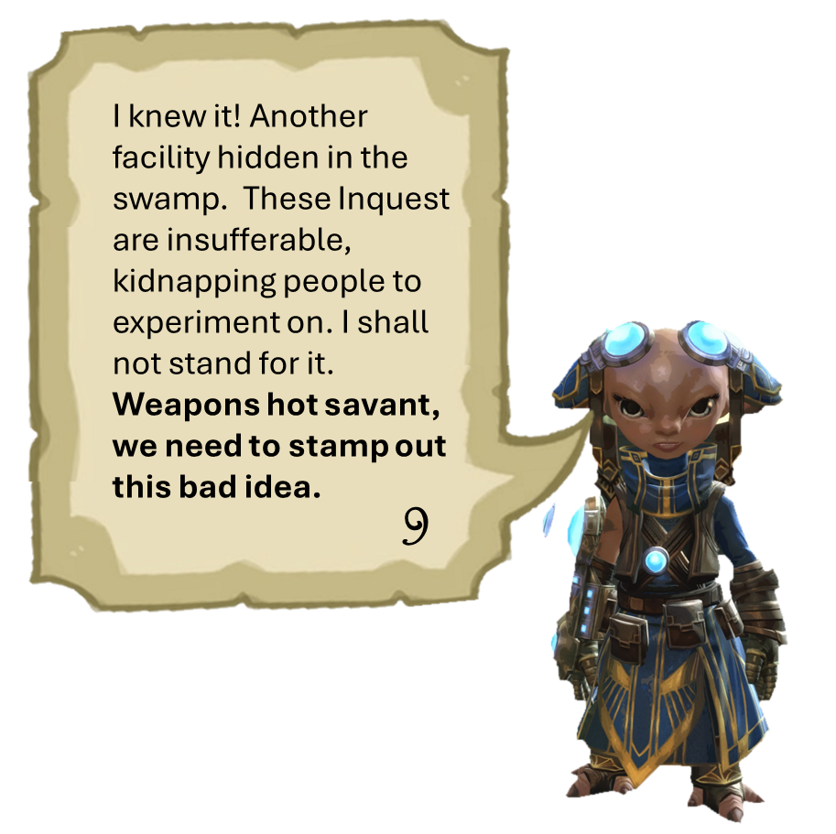
1-welcome inventor
2-brain washing
3-interrupting research
4-not even the frogs are safe, note about fun house
5-open up it’s the….
6-plot to disrupt power to metrica
7-too busy with the rats
8-zojja drops in to send a message, pick up a crafting profesion.
9- She heard from a frog about a hidden entrance. Go ask for more details
10-frogs talk about how hunters in west report weird lights
11-found corpses of skritt and krait around a chaotic shard, look for local skritt den
12-holy broken core
13-assault the complex to see about notes on the power grid plan
14-find hologram of assault plan, return and head over to luminates plant
15-return refugees and continue on over to powergrid
16-keep powergid safe
17-turrets online, inquest complex to north threatens
18-thinning the herd
19-recover note mentioning thaumanuova - sabotage golem
20-stolen core taken north, theft covered up by toxins from failed experiment stay and help or move on
21-go find the stolen reactor core
Glad you made it, while you are here, pick up something to equip yourself a little better. Peacemaker Alpp here mentioned disappearances along the swamp and not the invisibility kind.
Let’s see if the Inquest is somewhere in this swamp.
I knew it! Another facility hidden in the swamp. These Inquest are insufferable, kidnapping people to experiment on. I shall not stand for it.
Weapons hot savant, we need to stamp out this bad idea.
9
8

Slide 7
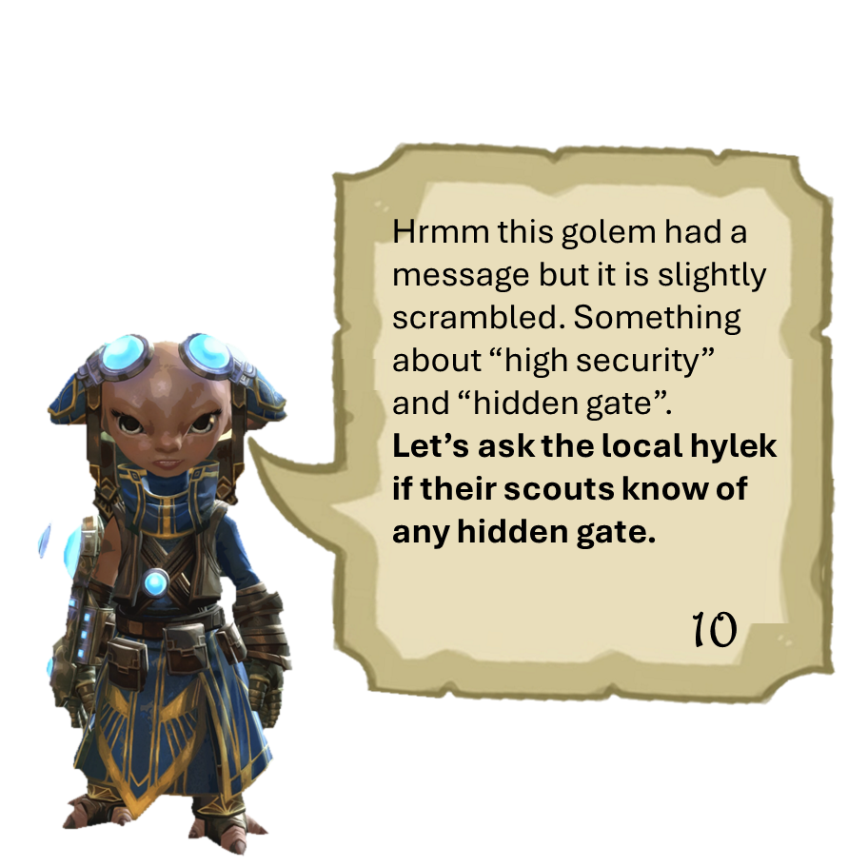
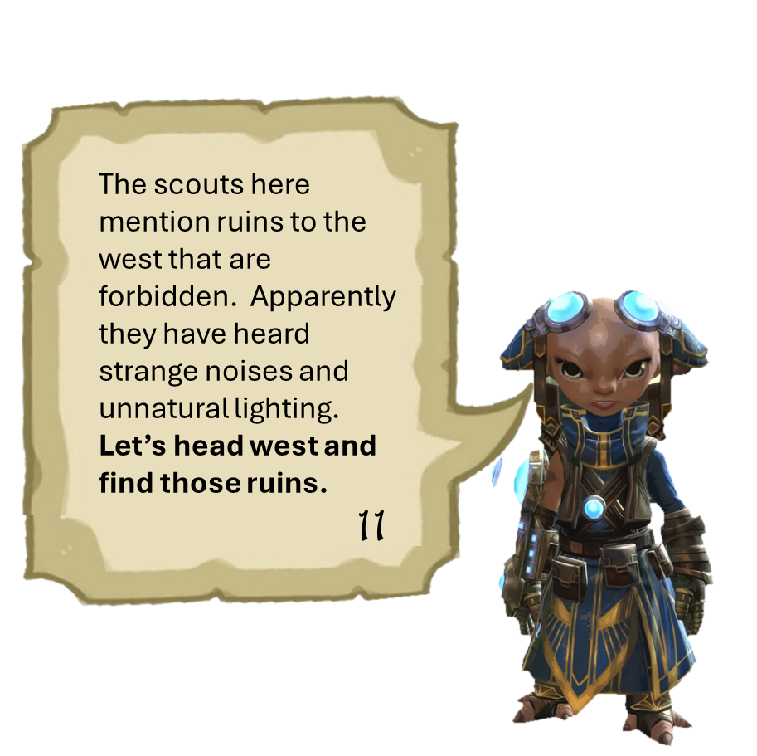
1-welcome inventor
2-brain washing
3-interrupting research
4-not even the frogs are safe, note about fun house
5-open up it’s the….
6-plot to disrupt power to metrica
7-too busy with the rats
8-zojja drops in to send a message, pick up a crafting profesion.
9- She heard from a frog about a hidden entrance. Go ask for more details
10-frogs talk about how hunters in west report weird lights
11-found corpses of skritt and krait around a chaotic shard, look for local skritt den
12-holy broken core
13-assault the complex to see about notes on the power grid plan
14-find hologram of assault plan, return and head over to luminates plant
15-return refugees and continue on over to powergrid
16-keep powergid safe
17-turrets online, inquest complex to north threatens
18-thinning the herd
19-recover note mentioning thaumanuova - sabotage golem
20-stolen core taken north, theft covered up by toxins from failed experiment stay and help or move on
21-go find the stolen reactor core
Hrmm this golem had a message but it is slightly scrambled. Something about “high security” and “hidden gate”.
Let’s ask the local hylek if their scouts know of any hidden gate.
The scouts here mention ruins to the west that are forbidden. Apparently they have heard strange noises and unnatural lighting.
Let’s head west and find those ruins.
11
10

Slide 8

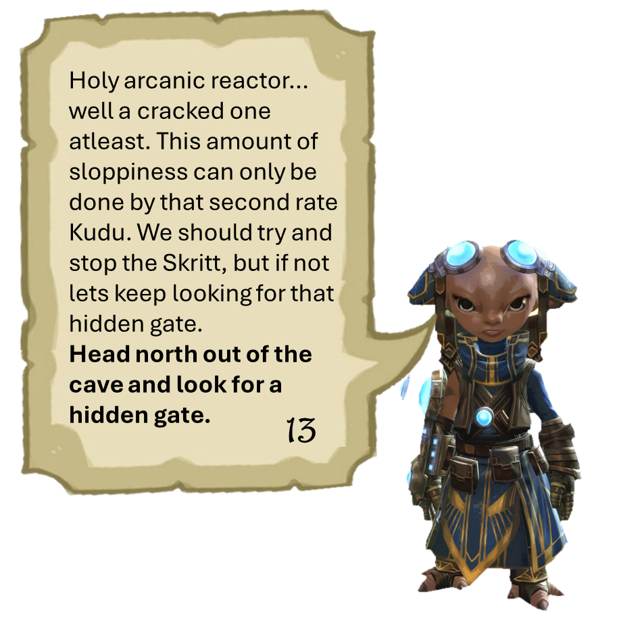
1-welcome inventor
2-brain washing
3-interrupting research
4-not even the frogs are safe, note about fun house
5-open up it’s the….
6-plot to disrupt power to metrica
7-too busy with the rats
8-zojja drops in to send a message, pick up a crafting profesion.
9- She heard from a frog about a hidden entrance. Go ask for more details
10-frogs talk about how hunters in west report weird lights
11-found corpses of skritt and krait around a chaotic shard, look for local skritt den
12-holy broken core
13-assault the complex to see about notes on the power grid plan
14-find hologram of assault plan, return and head over to luminates plant
15-return refugees and continue on over to powergrid
16-keep powergid safe
17-turrets online, inquest complex to north threatens
18-thinning the herd
19-recover note mentioning thaumanuova - sabotage golem
20-stolen core taken north, theft covered up by toxins from failed experiment stay and help or move on
21-go find the stolen reactor core
Ugh, not more rats… But I can see where the scouts would hear and see “unnatural lights”. These skritt are moving chaotically tainted material thinking its shiny. But where would they get chaotic material?
Head into the cave and find its source.
Holy arcanic reactor… well a cracked one atleast. This amount of sloppiness can only be done by that second rate Kudu. We should try and stop the Skritt, but if not lets keep looking for that hidden gate.
Head north out of the cave and look for a hidden gate.
13
12

Slide 9
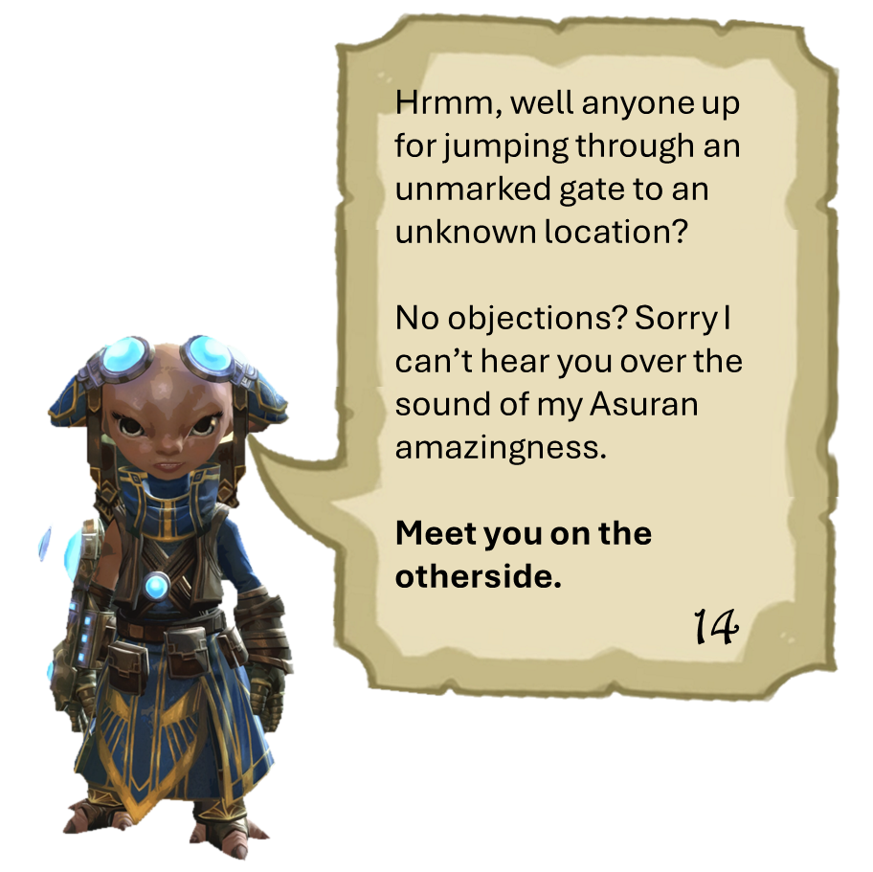
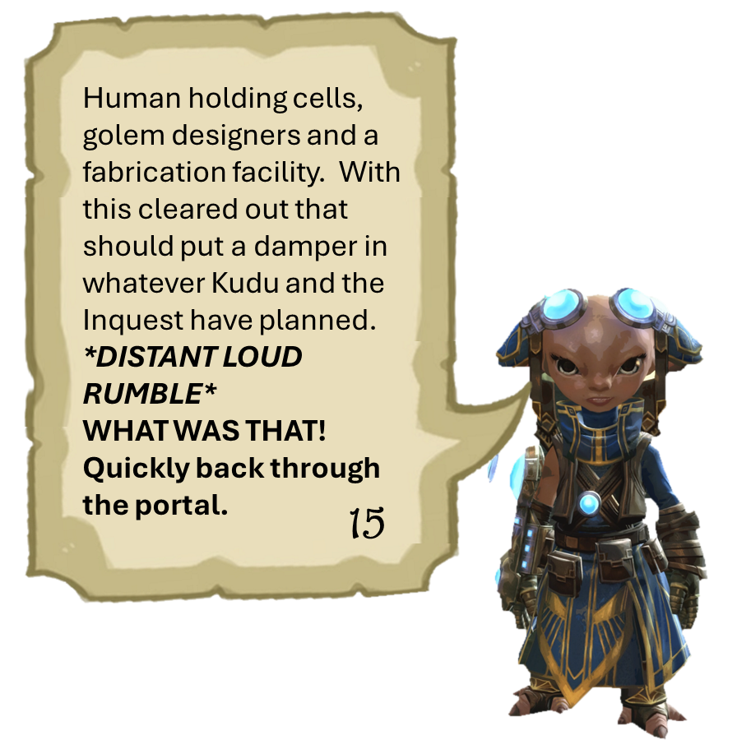
1-welcome inventor
2-brain washing
3-interrupting research
4-not even the frogs are safe, note about fun house
5-open up it’s the….
6-plot to disrupt power to metrica
7-too busy with the rats
8-zojja drops in to send a message, pick up a crafting profesion.
9- She heard from a frog about a hidden entrance. Go ask for more details
10-frogs talk about how hunters in west report weird lights
11-found corpses of skritt and krait around a chaotic shard, look for local skritt den
12-holy broken core
13-assault the complex to see about notes on the power grid plan
14-find hologram of assault plan, return and head over to luminates plant
15-return refugees and continue on over to powergrid
16-keep powergid safe
17-turrets online, inquest complex to north threatens
18-thinning the herd
19-recover note mentioning thaumanuova - sabotage golem
20-stolen core taken north, theft covered up by toxins from failed experiment stay and help or move on
21-go find the stolen reactor core
Hrmm, well anyone up for jumping through an unmarked gate to an unknown location?
No objections? Sorry I can’t hear you over the sound of my Asuran amazingness.
Meet you on the otherside.
Human holding cells, golem designers and a fabrication facility. With this cleared out that should put a damper in whatever Kudu and the Inquest have planned.
*DISTANT LOUD RUMBLE*
WHAT WAS THAT! Quickly back through the portal.
14
15

Slide 10
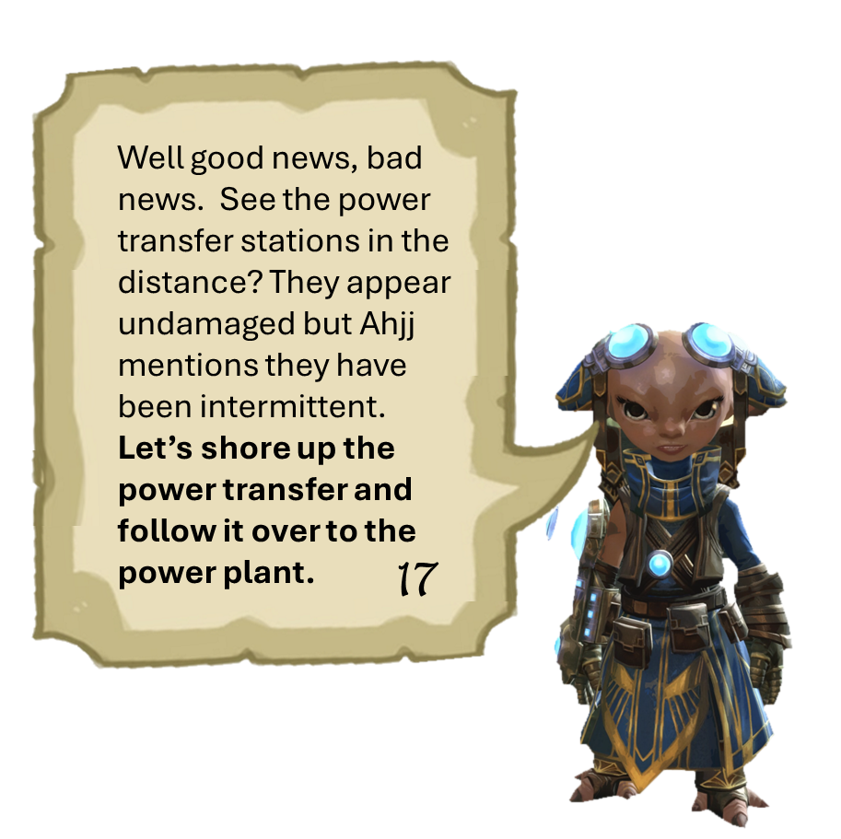

1-welcome inventor
2-brain washing
3-interrupting research
4-not even the frogs are safe, note about fun house
5-open up it’s the….
6-plot to disrupt power to metrica
7-too busy with the rats
8-zojja drops in to send a message, pick up a crafting profesion.
9- She heard from a frog about a hidden entrance. Go ask for more details
10-frogs talk about how hunters in west report weird lights
11-found corpses of skritt and krait around a chaotic shard, look for local skritt den
12-holy broken core
13-assault the complex to see about notes on the power grid plan
14-find hologram of assault plan, return and head over to luminates plant
15-return refugees and continue on over to powergrid
16-keep powergid safe
17-turrets online, inquest complex to north threatens
18-thinning the herd
19-recover note mentioning thaumanuova - sabotage golem
20-stolen core taken north, theft covered up by toxins from failed experiment stay and help or move on
21-go find the stolen reactor core
Gilga here tells me that the Inquest just blew up the reactor and have been kidnapping refugees. I let my guard down for one second and Kudu brings ruin. Mark my words…he will pay.
Let’s check on the powergrid station to the east and see how bad things are.
Well good news, bad news. See the power transfer stations in the distance? They appear undamaged but Ahjj mentions they have been intermittent. Let’s shore up the power transfer and follow it over to the power plant.
17
16

Slide 11
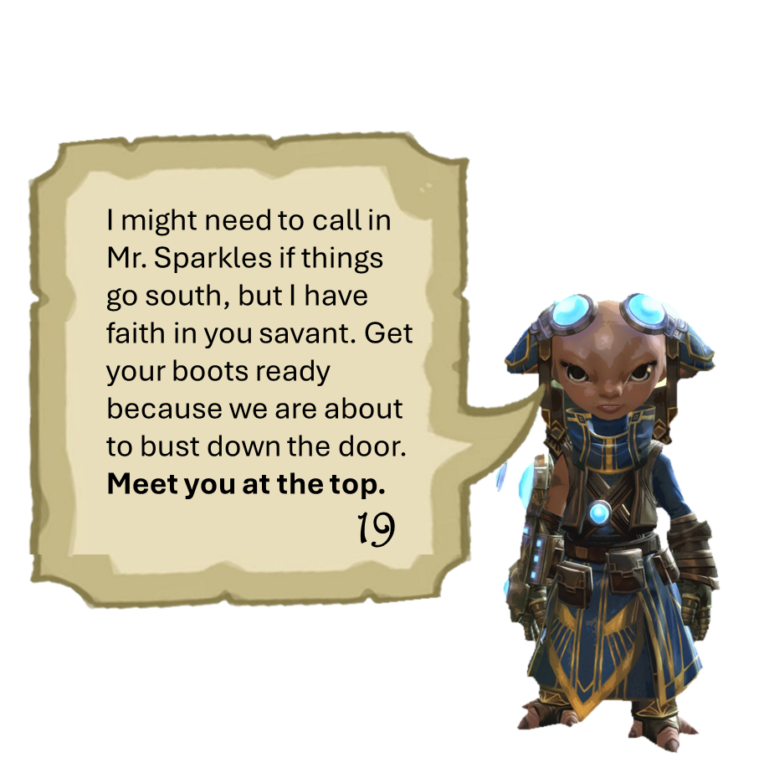
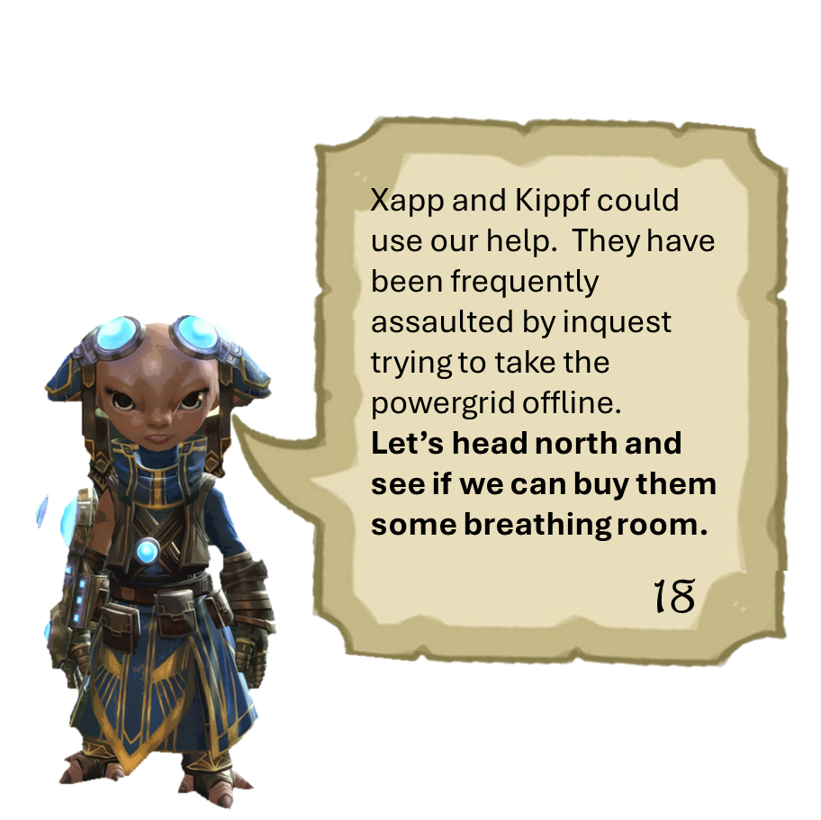
Xapp and Kippf could use our help. They have been frequently assaulted by inquest trying to take the powergrid offline.
Let’s head north and see if we can buy them some breathing room.
I might need to call in Mr. Sparkles if things go south, but I have faith in you savant. Get your boots ready because we are about to bust down the door.
Meet you at the top.
19
18

Slide 12
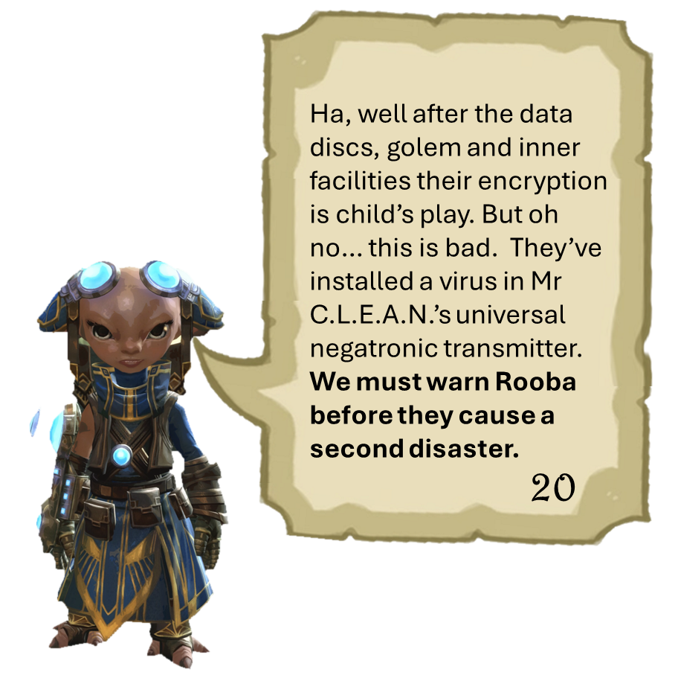
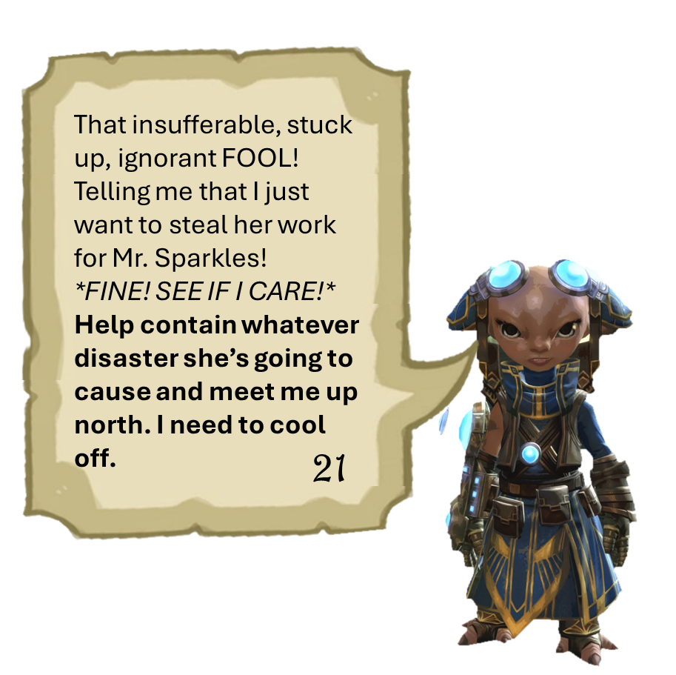
1-welcome inventor
2-brain washing
3-interrupting research
4-not even the frogs are safe, note about fun house
5-open up it’s the….
6-plot to disrupt power to metrica
7-too busy with the rats
8-zojja drops in to send a message, pick up a crafting profesion.
9- She heard from a frog about a hidden entrance. Go ask for more details
10-frogs talk about how hunters in west report weird lights
11-found corpses of skritt and krait around a chaotic shard, look for local skritt den
12-holy broken core
13-assault the complex to see about notes on the power grid plan
14-find hologram of assault plan, return and head over to luminates plant
15-return refugees and continue on over to powergrid
16-keep powergid safe
17-turrets online, inquest complex to north threatens
18-thinning the herd
19-recover note mentioning thaumanuova - sabotage golem
20-stolen core taken north, theft covered up by toxins from failed experiment stay and help or move on
21-go find the stolen reactor core
Ha, well after the data discs, golem and inner facilities their encryption is child’s play. But oh no… this is bad. They’ve installed a virus in Mr C.L.E.A.N.’s universal negatronic transmitter.
We must warn Rooba before they cause a second disaster.
That insufferable, stuck up, ignorant FOOL! Telling me that I just want to steal her work for Mr. Sparkles!
*FINE! SEE IF I CARE!*
Help contain whatever disaster she’s going to cause and meet me up north. I need to cool off.
21
20

Slide 13

1-welcome inventor
2-brain washing
3-interrupting research
4-not even the frogs are safe, note about fun house
5-open up it’s the….
6-plot to disrupt power to metrica
7-too busy with the rats
8-zojja drops in to send a message, pick up a crafting profesion.
9- She heard from a frog about a hidden entrance. Go ask for more details
10-frogs talk about how hunters in west report weird lights
11-found corpses of skritt and krait around a chaotic shard, look for local skritt den
12-holy broken core
13-assault the complex to see about notes on the power grid plan
14-find hologram of assault plan, return and head over to luminates plant
15-return refugees and continue on over to powergrid
16-keep powergid safe
17-turrets online, inquest complex to north threatens
18-thinning the herd
19-recover note mentioning thaumanuova - sabotage golem
20-stolen core taken north, theft covered up by toxins from failed experiment stay and help or move on
21-go find the stolen reactor core
Deep breathes…Deep breathes….UGH not working. But you know what does work, smashing some Inquest face in. They must have taken the Thaumanova core somewhere into Brisban.
Let’s see if we can pick up the trail at Mrou Boru.
22

Slide 14
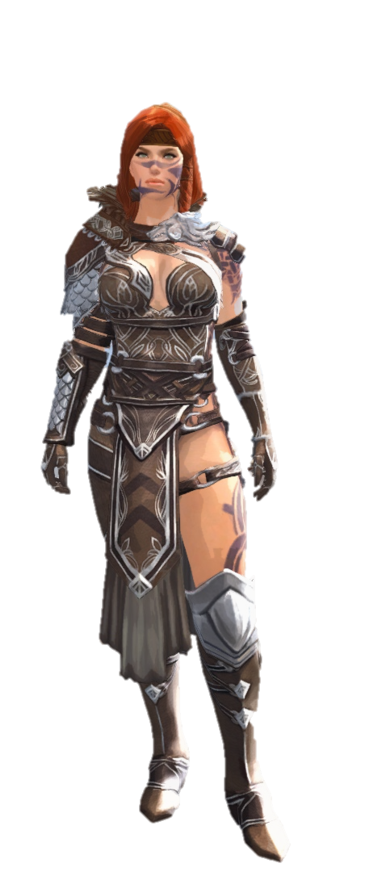

Slide 15
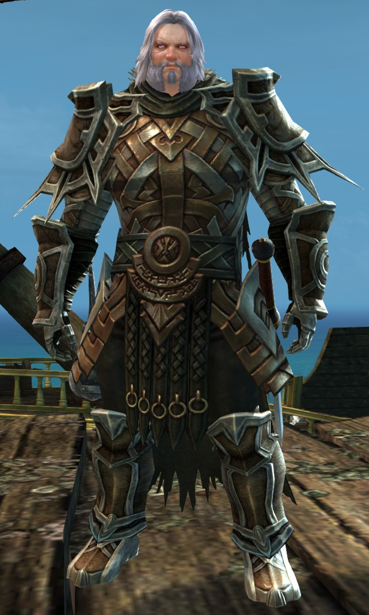
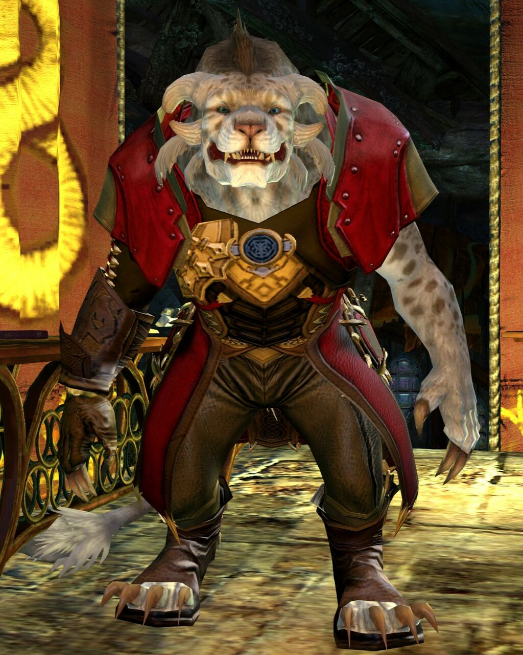
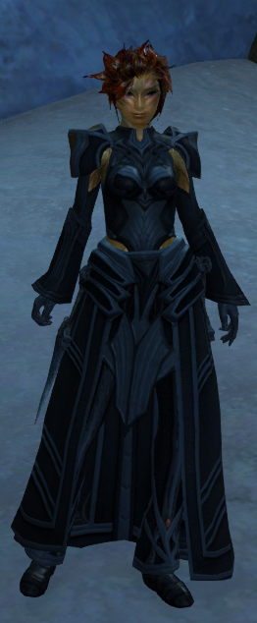

Slide 16
